Slide 1


E-Commerce Sales Analysis
From raw data to business decisions
with Python and Power BI
Presented By Abdalla Mohamed

Slide 2
  Raw sales data is messy: duplicates, missing values, outliers
  Dashboards describe what happened, but the business also needs to know why and what’s next
The Problem
Goal: clean the data, test business questions statistically, forecast revenue, and report it in Power BI

Slide 3

The Data
  5,000 orders, 14 columns, October 2023 to October 2025
  Fields: order date, region, category, product, quantity, unit price, discount, sales, profit, payment mode
  Quality check: 0 duplicates, 0 missing values
  Added features: profit margin, discount group, order-value tier
صفحة 3

Slide 4
Pipeline Overview
Key Performance Indicators
  Load and inspect
  Clean: remove duplicates, handle missing values
  Engineer features: year, month, quarter, margin
  Calculate KPIs
  Test hypotheses: t-test, ANOVA, chi-square
  Forecast: ARIMA/SARIMA
  Report: Power BI dashboard
  Total revenue: 533.7M
  Total profit: 79.7M
  Orders: 5,000
  Average order value: 106,733
  Average profit margin: about 15%
صفحة 4

Slide 5

  Weekly revenue, 103 complete weeks
  Stationarity confirmed by ADF and KPSS tests
  No trend (p = 0.94) and no calendar seasonality (p = 0.98)
  Split: 80% train, 20% test, in time order
  Model: SARIMA(2,0,0)×(0,0,1,13), chosen by training AIC
  Output includes a 95% prediction interval
Forecasting Approach
  Test error: RMSE about 1.25M, MAPE about 20%
  The 95% interval covered 90.5% of the test weeks, so the uncertainty is realistic
  Next 12 weeks: about 5.1M per week, 95% range roughly 3.1M to 7.2M
  Honest note: the model is only marginally better than predicting the historical average
Forecast Results
صفحة 5

Slide 6
Phase 1 — Testing Business Questions
It checks three things:
① Do discounts hurt sales or profit?
  Compares high-discount orders vs low-discount orders
  Tests both order value and profit margin
  Tells you if the difference is real or just random
② Do sales differ by region?
  Compares average order value across all regions
  If they differ, it tells you which regions differ from each other
③ Are category, region, and payment mode linked?
  Checks if payment method depends on category, region, or order size
  Example: "Do high-value orders use a different payment method?"
Output: A summary table + one chart showing the key results.
Python
This script does two things with your e-commerce sales data:
  Tests business questions using statistics
  Predicts future sales using time-series models
Phase 2 — Predicting Future Sales
It builds a forecast of weekly revenue.
Steps it follows:
  Group data into weekly totals
  Check if the data is stable over time (stationarity check)
  Look at patterns — trend, seasonality, autocorrelation (makes 4 plots)
  Split data — 80% to train the model, 20% to test it
  Try many models — plain ARIMA and seasonal SARIMA, pick the best by AIC score
  Test the winner — compare its forecast against simple guesses (average, last value) using RMSE and MAPE
  Forecast the next 12 weeks using the best model
Output: Model comparison table + 2 forecast charts + future forecast CSV.
صفحة 6

Slide 7
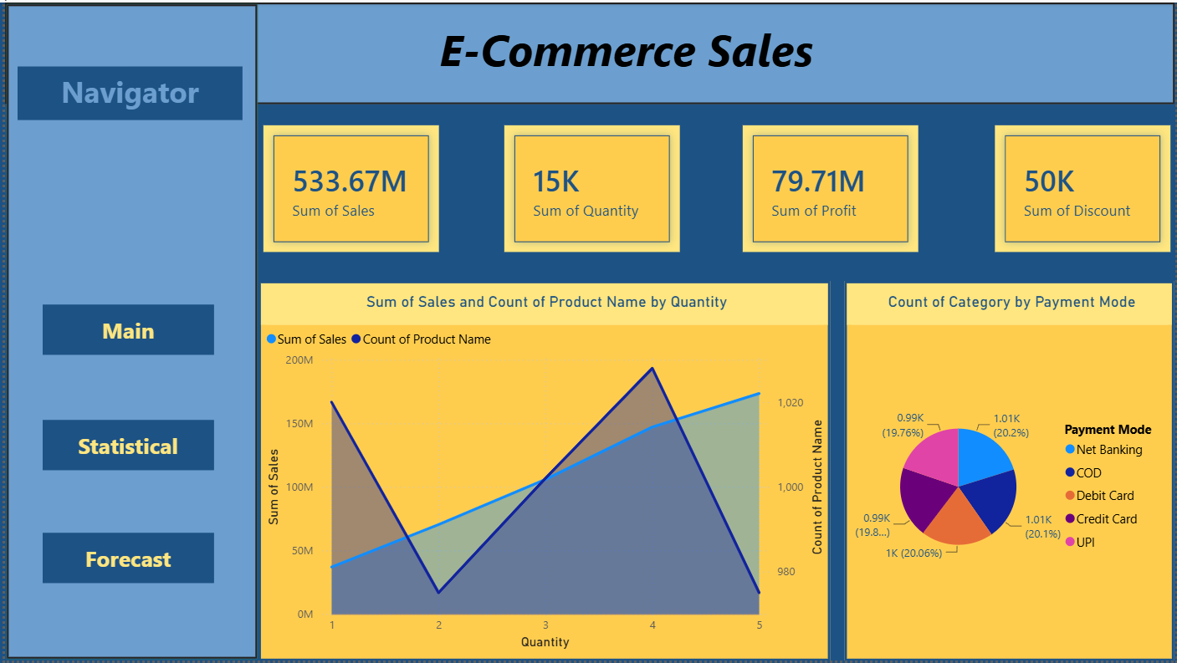
Power Bi
Main:

Slide 8
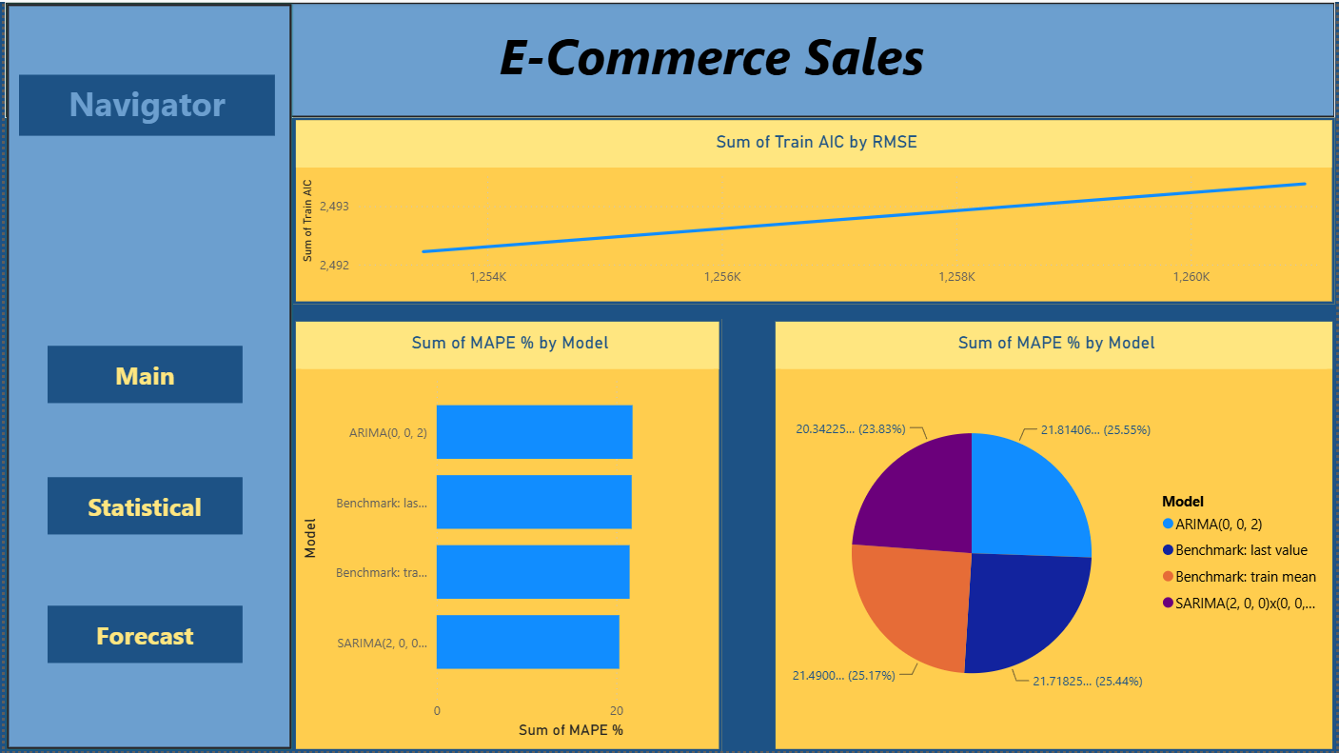
Power Bi
Statistical:

Slide 9
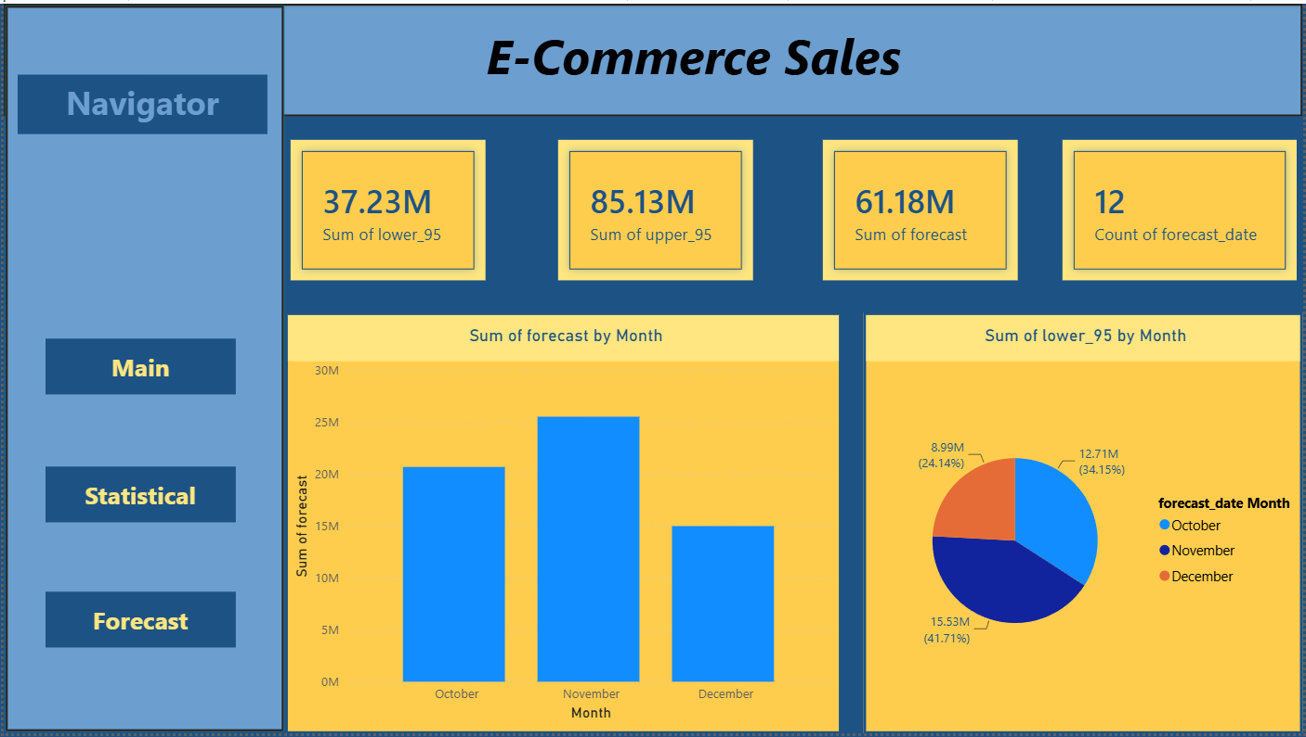
Power Bi
Forecast:

Slide 10




Project Links
Github
https://github.com/Abdalla820/E-Commerce-Sales
Kaggle Dataset
https://www.kaggle.com/datasets/prince7489/e-commerce-sales
صفحة 10

Slide 11



Thank you
To contact With Me:
Linked in
صفحة 11

